Slide 1

TOOSSAB
Consulting Engineers Co.

Slide 2

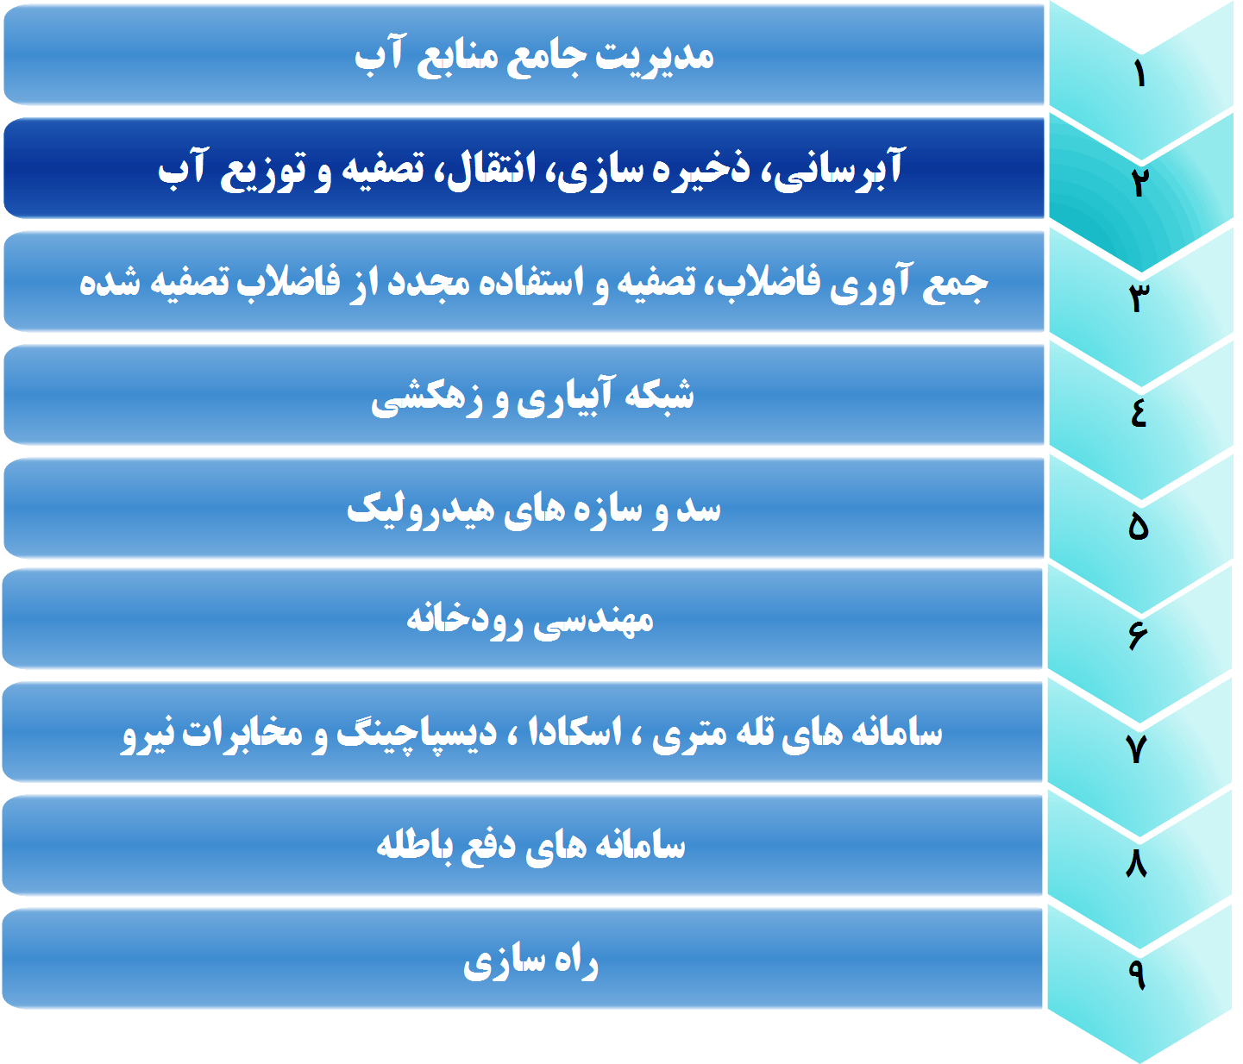
زمینه فعالیتهای شرکت
T
O
O
S
S
A
B
شرکت مهندسی مشاور طوس آب درسال 1363 تاسیس گردید و تاکنون بیش از 500 طرح مطالعاتی، تحقیقاتی و اجرايی در داخل کشور و 14پروژه خارجی را بعهده داشته است .
فعاليتها :

Slide 3
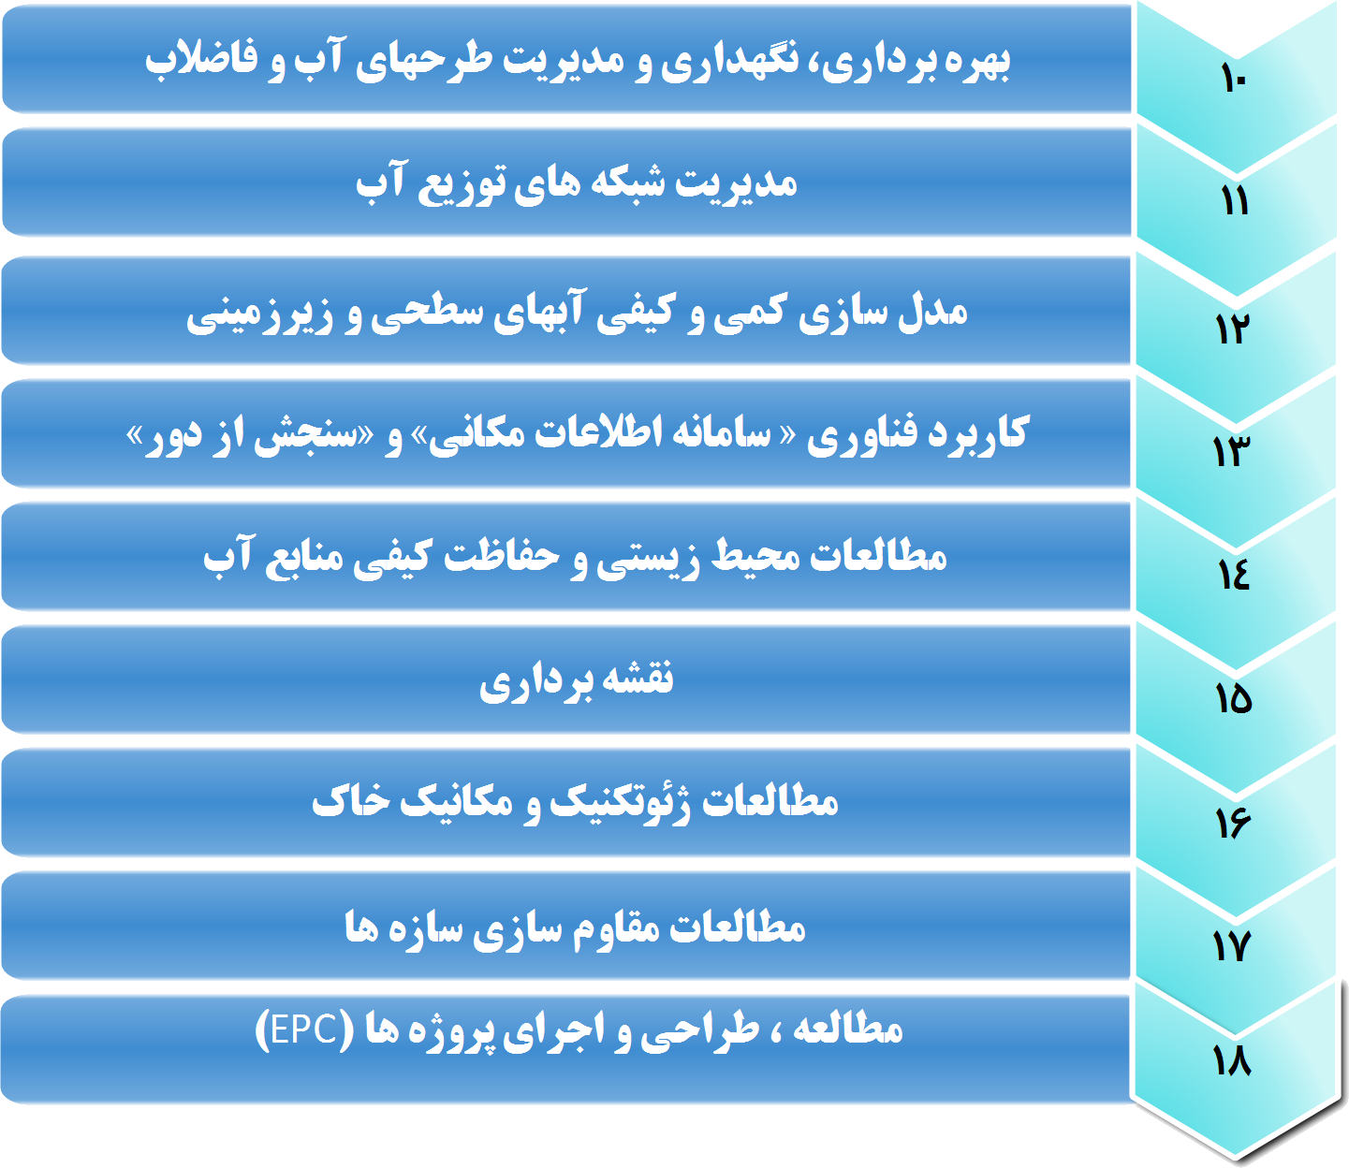
زمینه فعالیتهای شرکت
T
O
O
S
S
A
B

Slide 4

پروژه هاي برون مرزي(انجام شده تاکنون)
طرح سد مشترک دوستی ( مرز ايران و تركمنستان )
طرح انتقال آب، شبكه آبياري و نیروگاه برقابی گمبيري (مرحله اول) ( افغانستان )
طرح تصفیه خانه ، تلمبه خانه و خط انتقال آب شهر مرو ( تركمنستان )
طرح جامع مدیریت منابع آب حوضه آبریز کابل (افغانستان )
طرح آبرساني از آمو دريا به شهر اندخوي (افغانستان )
طراحی و اجرای خط انتقال ،ایستگاههای پمپاژ، مخازن سرویس و شبکه توزیع آب شهر
اندخوی (افغانستان)
طرح آبرسانی به شهر زرنج (افغانستان)
TOOSSAB

Slide 5
پروژه هاي برون مرزي (در دست اقدام)
مطالعات طرح توسعه ( بازسازی و ارتقاء ) تصفیه خانه فاضلاب شهر حلب (سوریه)
طرح مطالعات انتقال آب، شبکه آبیاری و نیروگاه برقابی گمبیری (مرحله دوم) (افغانستان)
اجرای 80 کیلومتر شبکه جمع آوری فاضلاب منطقه کافوری-شهر خارطوم (سودان)
مطالعات اصلاح و توسعه تصفیه خانه فاضلاب مجتمع نیشکر کنانا (سودان )
مطالعات اصلاح فرایند فرآوری صنعتی نیشکر در مجتمع نیشکر کنانا(سودان)
خط انتقال فاضلاب منطقه سوبا – شهر خارطوم (سودان )
اجراي پروژه تامين آب جزيره فازا (كنيا)
TOOSSAB

Slide 6
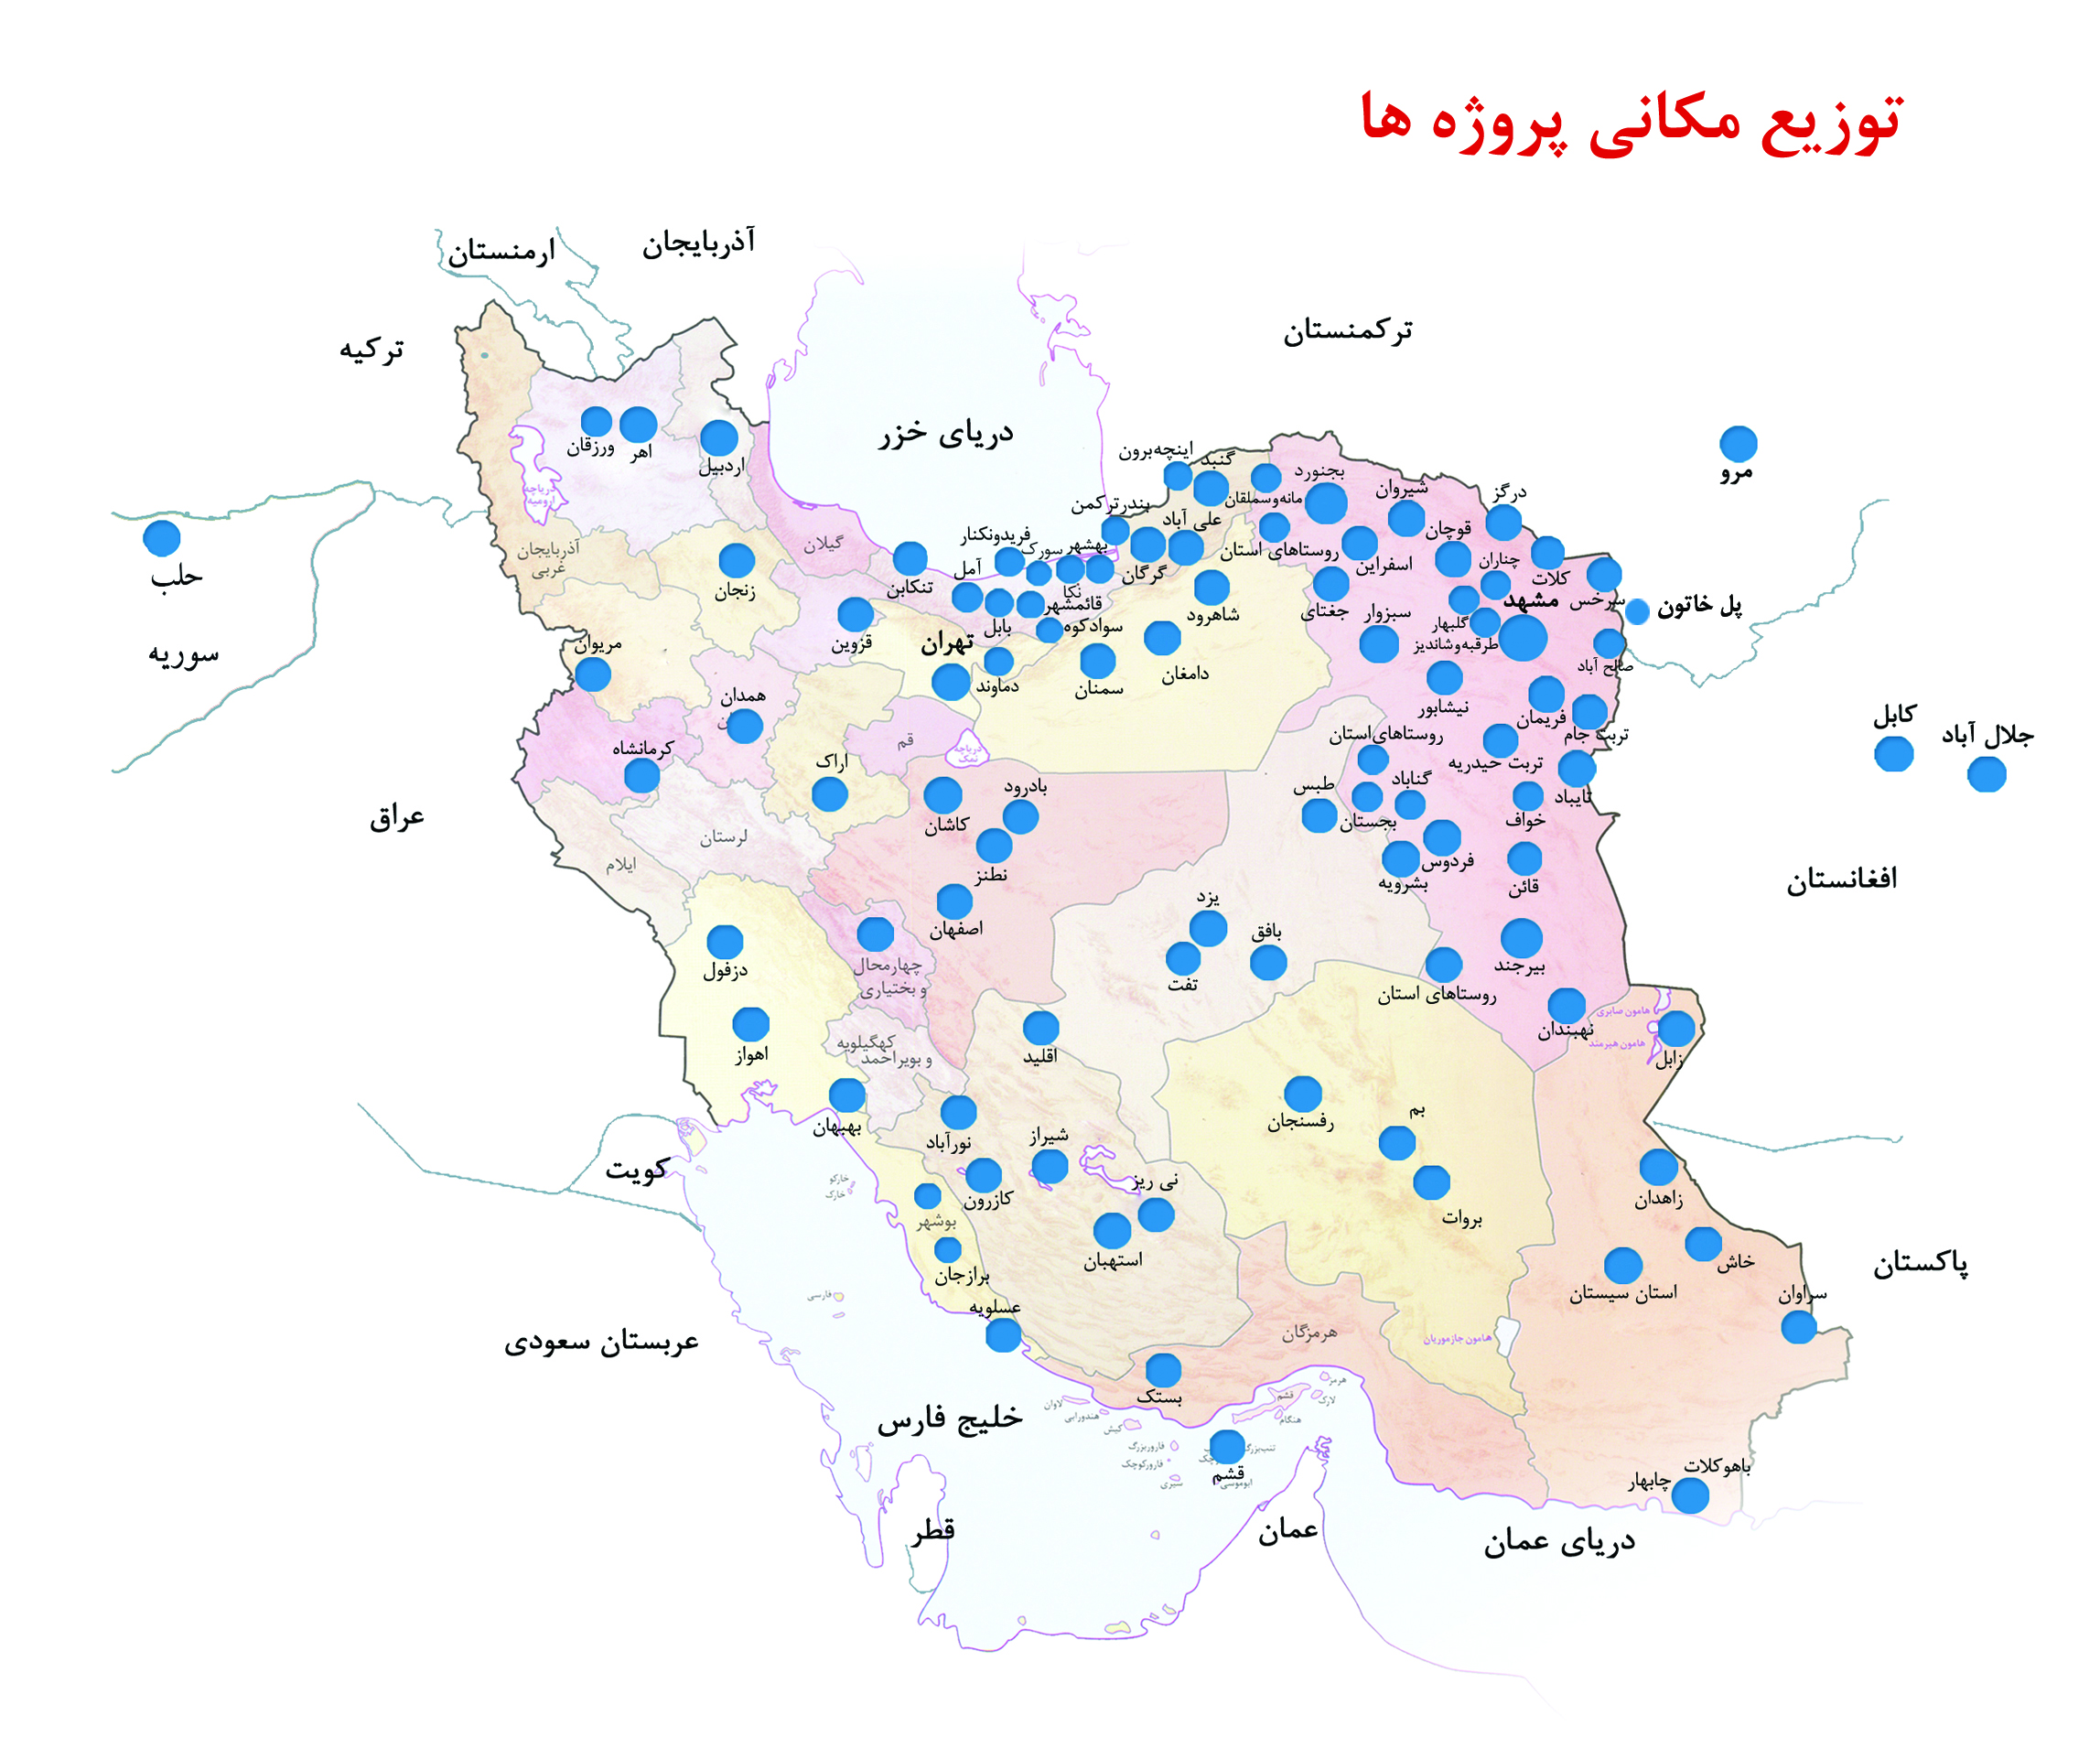
در داخل ایران
T
O
O
S
S
A
B

Slide 7
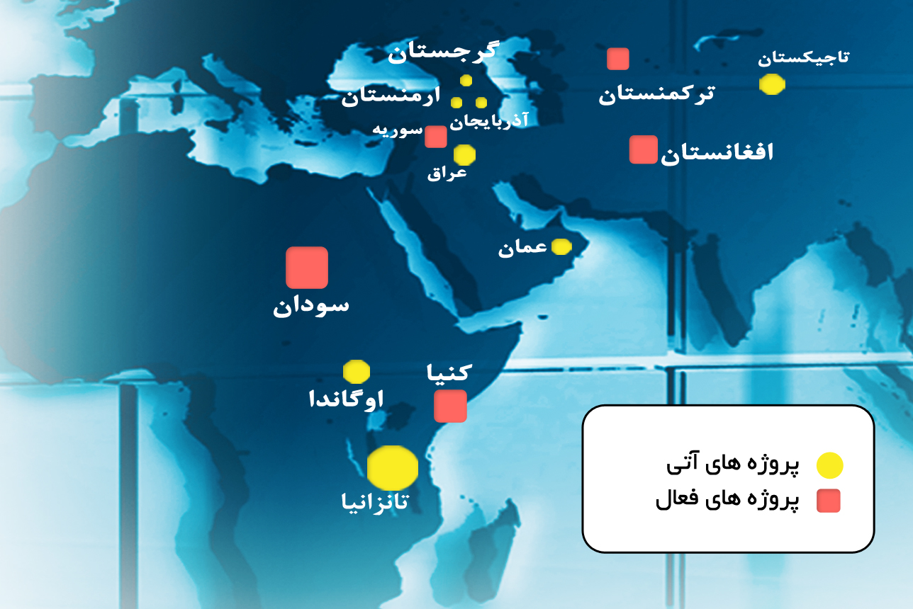
توزیع مکانی پروژه های خارجی
T
O
O
S
S
A
B

Slide 8
سهم منابع مختلف آب برای آب شیرین کن ها

Slide 9
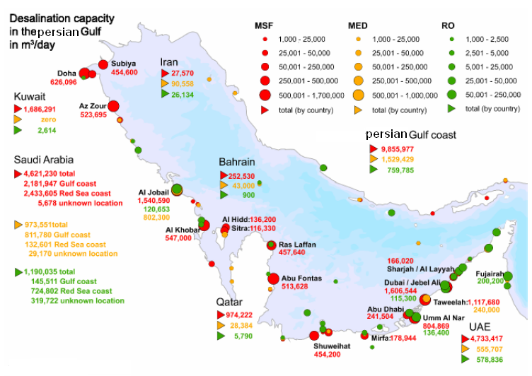
وضعيت شيرين سازي آب در محدوده خليج فارس

Slide 10
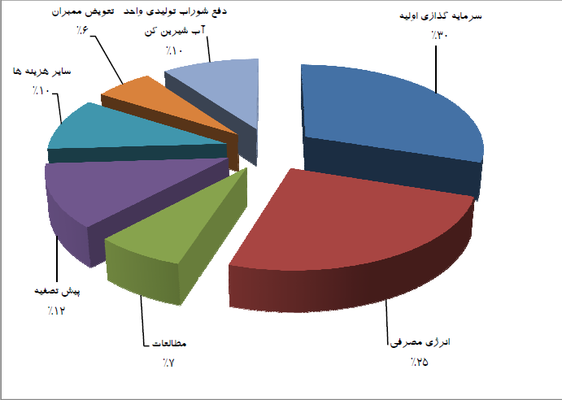
مروری بر اقتصاد نمک زداییمروری بر اقتصاد نمک زدایی

Slide 11
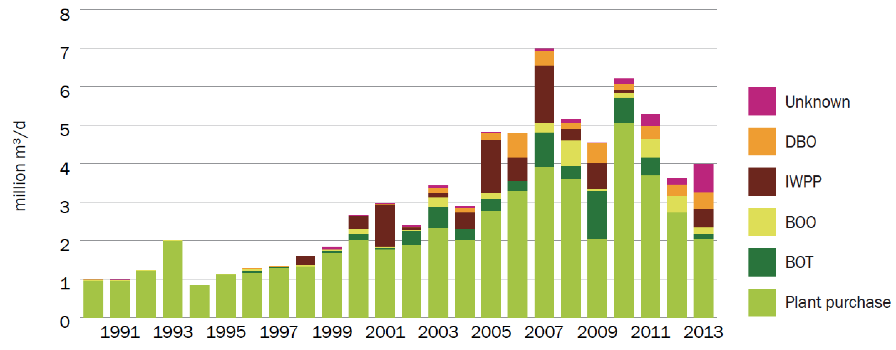
Annual Capacity by Delivery Model

Slide 12
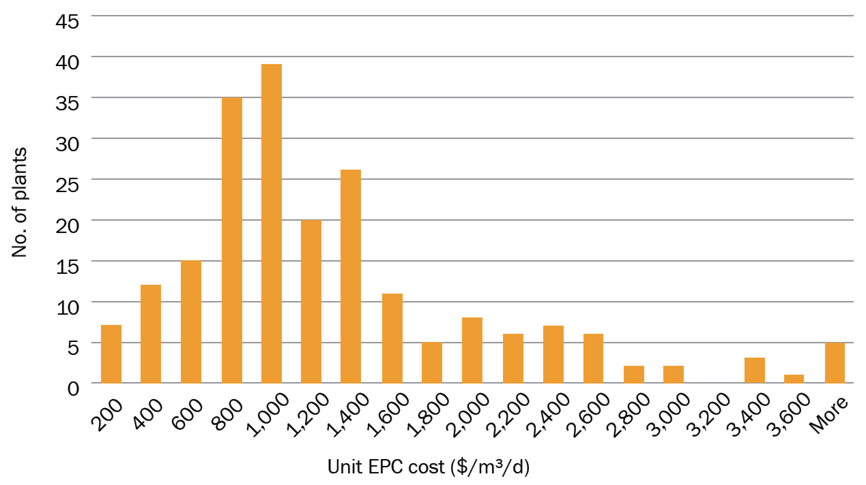
SWRO CapEx

Slide 13
قیمت اولیه آب تولیدی واحدهای نمک زدایی

Slide 14
ارزیابی آینده نمک زدایی
Site and main equipment | SWRO | BWRO | WWRO
Site preparation and building | Location depended. Potential for cost reduction with standardization of systems configuration
Intake and outfall (brackish wells and concentrate disposal) | Significant potential for cost increase due to stricter environmental regulations | No changes of feed water supply cost. Potential for cost increase of concentrate disposal | No changes of cost of feed supply or concentrate disposal
Feed water pretreatment | Potential for cost reduction through development of effective methods for membrane fouling reduction
 |  |  | integration with MBR process
RO trains | Potential for cost reduction with standardization of systems configuration
RO membrane elements | Small potential for cost reduction
Piping, valves | Some potential for cost reduction through better understanding of corrosion potential and use of polymeric materials
High pressure pumps and energy recovery devices | Some potential for cost reduction through better understanding of corrosion potential and use of polymeric materials

Slide 15
ارزیابی آینده نمک زدایی
Direct capital cost | SWRO | BWRO | WWRO
Electrical & MCC | No changes expected
Permeate post treatment, storage and delivery | No changes expected
Membrane cleaning system | No changes expected
Instrumentation and control system | Small reduction due to cost reduction of electronic components and standardization of process control programs
Indirect capital cost | SWRO | BWRO | WWRO
Engineering | Some reduction due standardized design | No changes expected | No changes expected
Interest during construction | No changes expected | No changes expected | No changes expected

Slide 16
ارزیابی آینده نمک زدایی
Indirect capital cost | SWRO | BWRO | WWRO
Engineering | Some reduction due standardized design | No changes expected
Owners cost | Reduction possible with reduction of length of permitting process | Increase possible with stricter regulation of concentrate disposal | No changes expected
Interest during construction | No changes expected
Variable operating cost components | SWRO | BWRO | WWRO
Power | Small reduction due to slight improvement of pumping equipment efficiencies
Chemicals | Some reduction due to reduction of chemical usage | No significant changes | Some reduction due to reduction of chemical usage
Replacement of membranes and cartridge filters | Some cost decrease due to reduction of membrane fouling rate | No significant changes | Some cost decrease due to reduction of membrane fouling rate

Slide 17
ارزیابی آینده نمک زدایی
Constant operating cost components | SWRO | BWRO | WWRO
Labor | Some reduction due to higher degree of process automation | No significant changes
Spare parts and maintenance | Some reduction due to increased reliability of system components | No significant changes | Some reduction due to increased reliability of system components
Regulatory monitoring | Some cost increase do to increase of monitoring requirement | No significant changes | Some cost increase do to increase of monitoring requirement

Slide 18

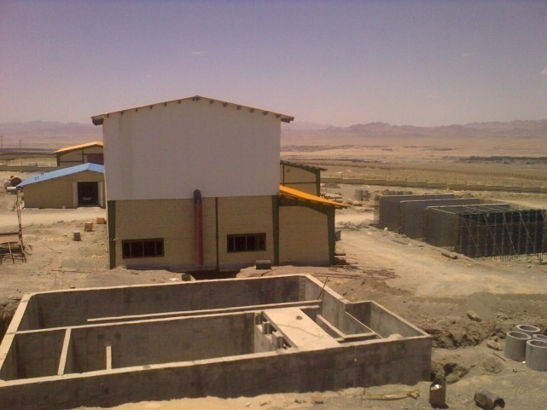
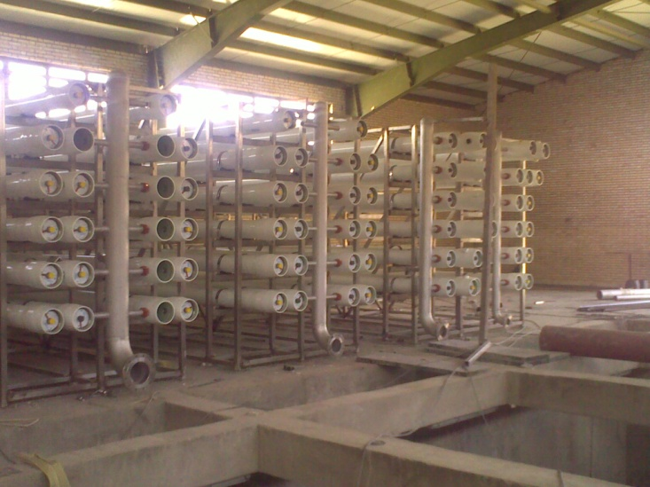
Birjand
Hybrid RO & Pellet reactor Water Treatment PLANT
بسم الله الرحمن الرحیم
TOOSSAB consultancy
A.Farahmand Meng. S. Nairizi PHD
a.farahmand@toossab.net
www.toossab.net

Slide 19
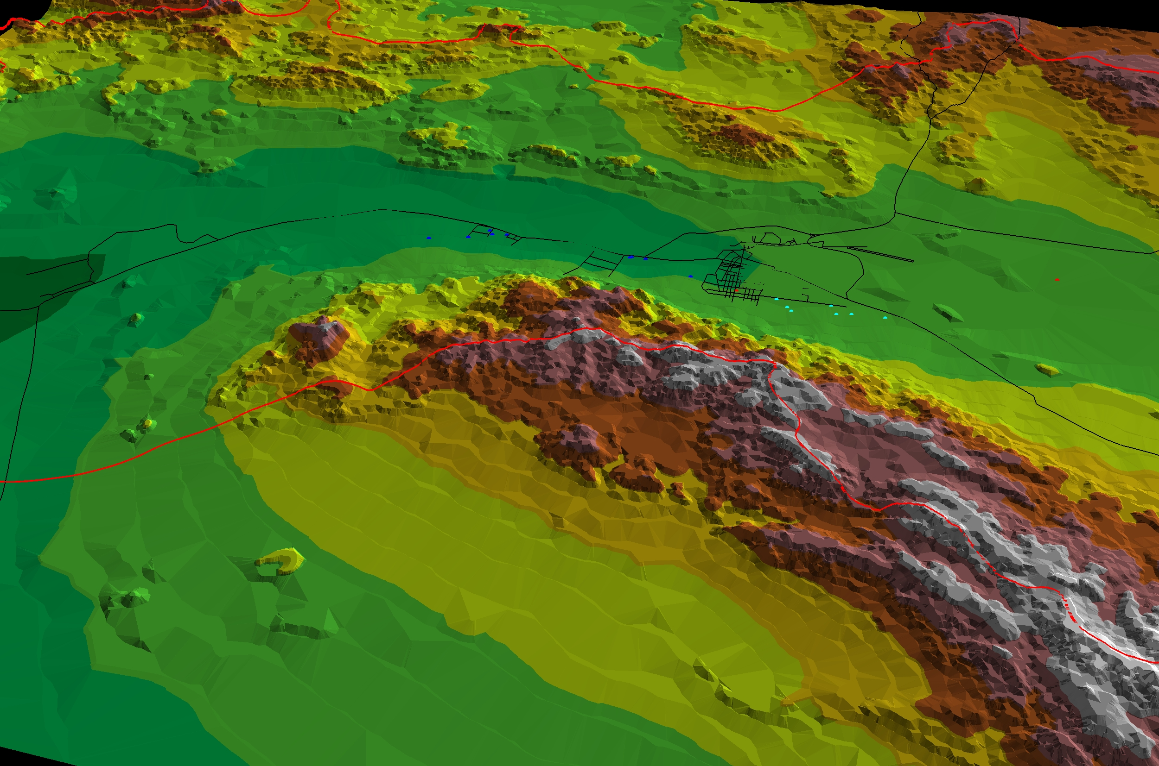
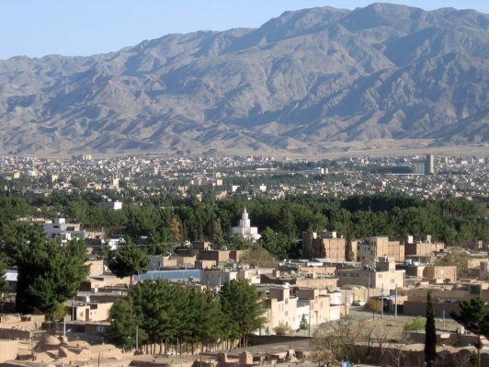
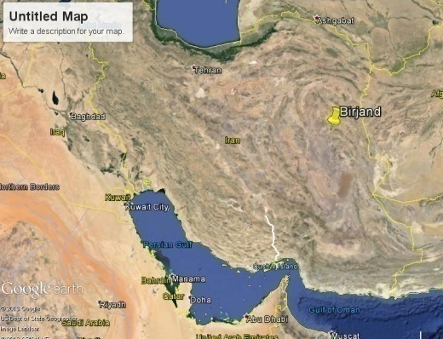
Existing Water Sources of Birjand
7 Deep wells
Birjand
10 Deep wells
WTP Location

Slide 20
Water Quality
Parameter | Concentration (mg/lit)
PH | 8
M Alkalinity | 260
P Alkalinity | 7
TDS | 3500
Total Hardness | -
Cl⁻ | 580
SO₄⁻ | 552
NO₃⁻ | 20
NO₂⁻ | 1
PO₄³⁻ | 0.5
CO₃²⁻ | 3.4
HCO₃⁻ | 246
Cr⁶⁺ | 0.15
Ca²⁺ | 80
Mg²⁺ | 155
Na⁺ | 350
K⁺ | 15
Excess heavy metal
High hardness content
CrIII ,VI
taste of Water

Slide 21
Option 2:
Hybrid RO & softening
RO
Changing the typical concept of series process and make it Hybrid with simple parallel arrangement of steps!
step1
step2
PR
RO

Slide 22
Why!!
Lowering the marginal amount of salinity and sulfate
Keep the secondary standard of water to more acceptable level(Taste)
Reducing the marginal level of heavy metals beyond the guideline
Keeping the most valuable minerals of water to reasonable level

Slide 23
Option2:Hybrid process
Dividing flows for achieving to best concentrations
PH
Adjustment
Q=420 lit/s
Q=415 lit/s
Pellet reactor softening
Q=632 lit/s
Q=640 lit/s
Nano + Reverse osmosis
Q=190 lit/s
Q=220 lit/s
Reuse
WWTP effluent
Q=30 lit/s
Q=150 lit/s
Agricultural purpose
Q=120 lit/s
Waste water effluent

Slide 24
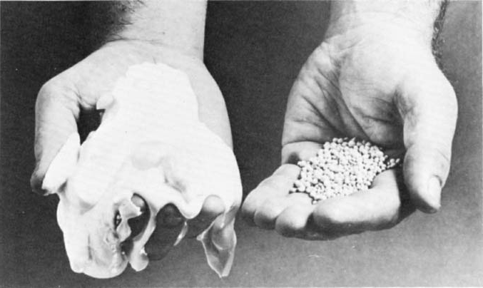
Softening
Q=315 lit/s
Rapid sand
filter
Pellet reactor
PH>8 , 4 unit
Lamella
sedimentation
Q=420 lit/s
Pellet reactor
PH>11 , 1 unit
Astra sand
filter
Lamella
sedimentation
Q=105 lit/s
Dry pellet
Q=0.5lit/s
sludge
Drying bed
Dried Sludge

Slide 25
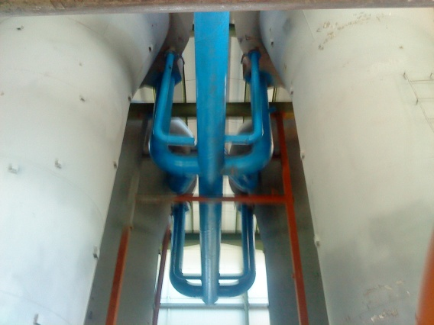
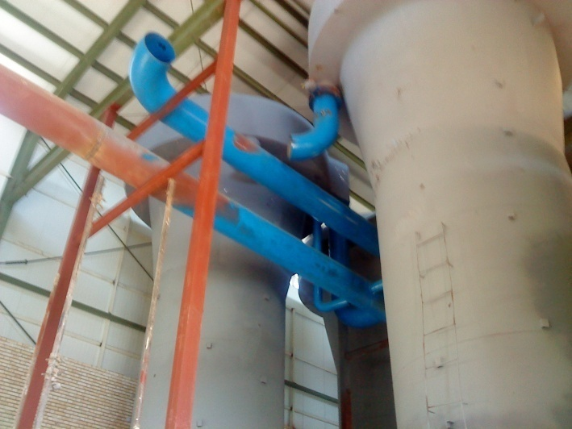
Softening
Advantage of pellet reactor:
Small footprint
Low detention time
Decreasing of watery sludge
Decreasing of heavy mental

Slide 26
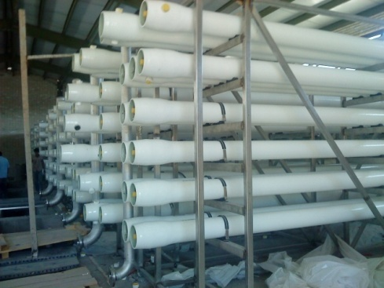
Reveres osmosis
Q=154 lit/s
R70%
Q=123 lit/s
R80%
NANO
LP RO-1
Q=220 lit/s
Q=24 lit/s
R80
Q=30 lit/s
Q=190 lit/s
R86
Q=66 lit/s
RO-2
TDS mg/l | 1900
Cr mg/l | 0.1
SWRO
Q=43 lit/s
R65
Q=29 lit/s
20413 | TDS
1.232 | Cr
6.8 & 11.5 bar

Slide 27
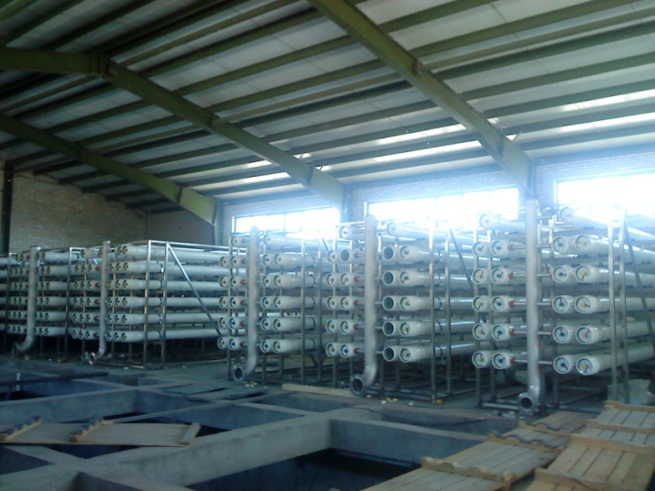

Reveres osmosis
Advantage:
Decreasing of TDS
Decreasing of hardness
Chrome removal
Birjand RO Unit with capacity of 220 lit/s

Slide 28

Lamella setteling
Number=4
Area=37/8 m
CL2 9.21 kg/hr
NaHSO3 106 kg/hr
Number=4
3
Row Water
Q=420 lit/s
Low
ph
high
ph
Backwash to Recovery
Reaction chamber
Tank
V=272.6 m
PH
Adjustment
Q=220 lit/s
Filter
Sludge thickeners
3
V=27.3 m
3
Lime 594 mg/l
Soda ash 52 mg/l
Caustic soda 58 mg/l
Cartridge
filter
Q=420 lit/s
Dual
Media
filter
Drying bed
Area=218 m
Q=167 lit/s
2
Nano & RO
Mixing tank
Q=605 lit/s
Reuse
MCC
Room
Chemical room
Process Block Diagram

Slide 29
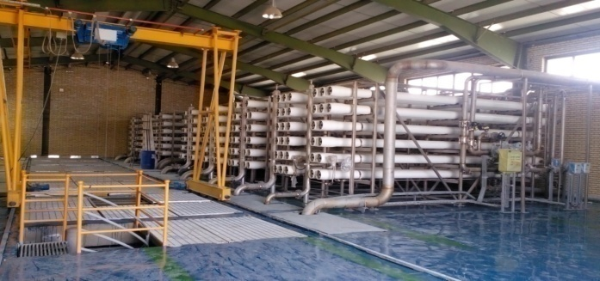
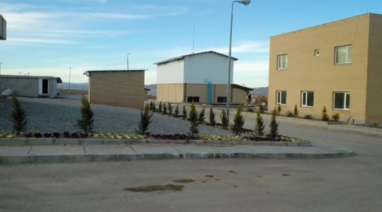
Energy consumption comparison
Pellet & RO hybrid |  |  | RO 640 lit/s | Energy
RO&PR 220+450 | Pellet 450lps | RO 220lps
1100 | 130 | 970 | 2800 | Energy consumption Kw/hr
0.5 kw/m3 |  |  | 1.5 kw/m3

Slide 30
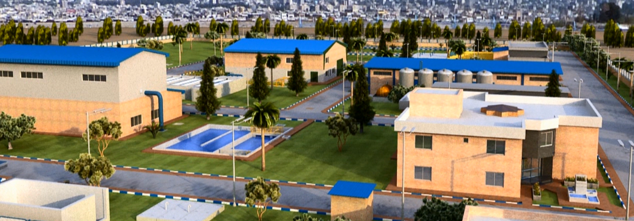
Hybrid Cost comparison
Pellet & RO hybrid | RO 640 lit/s | Cost (MUSD)
RO&PR 220+450
11.221M$ | 24.783 M$ | Initial capital investment
0.28 $/m3 | 0.31$ | Total operation cost

Slide 31
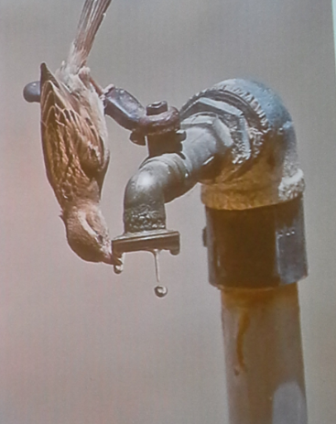
با تشکر از توجه شما!

